Slide 1

Ensemble Learning
Ali Nazari

Slide 2
Overview
So far, we have discussed two learning techniques
k-nearest neighbor classification/regression
decision-tree classification/regression
In this lecture, we will discuss a new technique called ensemble learning
Combine many weak classifiers/regressors and create a better one
Wisdom of crowd: suppose you ask a complex question to thousands of random people. Typically their aggregated answer is better than individual’s
We will also discuss:
generalization using bias/variance decomposition
Methods of ensembles learning:
bagging: reduce the variance
boosting: reduce the bias

Slide 3
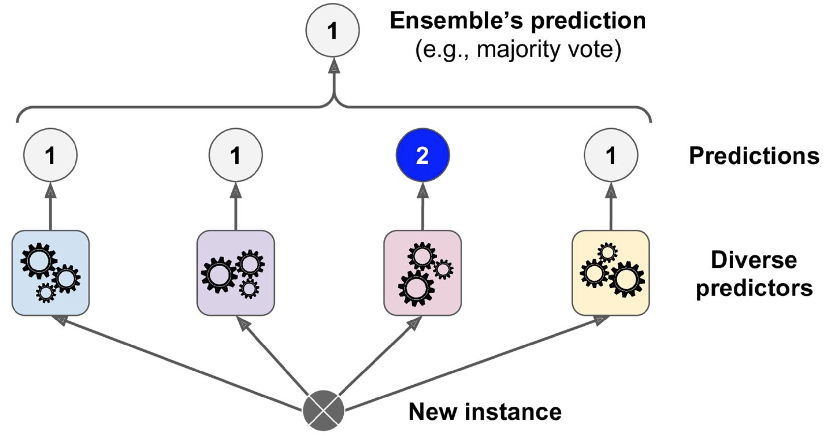
Ensemble method- majority voting
An ensemble of predictors is a set of predictors whose individual decisions are combined in some way to classify new examples
Suppose you have trained a few classifiers, each of which have good accuracy
Logistic regressions, decision tree, knn,…
A very simple way to create a better classifier is to aggregate the prediction of the simple classifiers
Aggregation can be something simple like weighted majority vote
The ensemble classifier achieves higher accuracy than the best classifier in the ensemble
Source: Hands on Machine learning with scitkit-learn and tensorflow

Slide 4
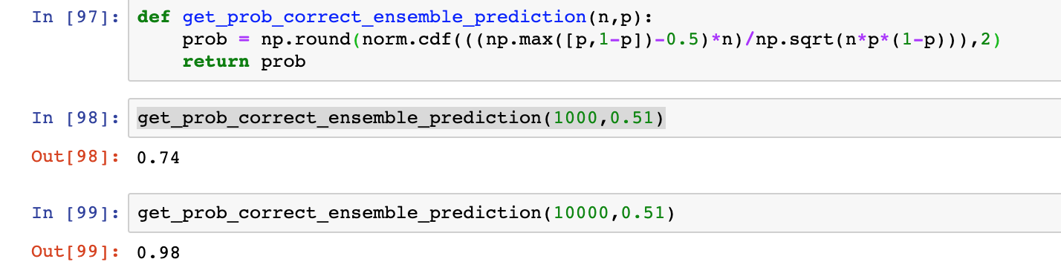
Ensemble method- majority voting
Why does it improve the performance?
Suppose that we have built an ensemble containing 1000 independent weak classifiers
Each weak classifier is correct only 51% of the time
We get the prediction of all classifiers and use the majority vote
the probability of being correct is about 75% (strong classifier)
Source: Hands on Machine learning with scitkit-learn and tensorflow

Slide 5
Ensemble methods
The 75% accuracy can only be achieved if all classifiers are perfectly independent
This cannot be the case in machine learning if we use same data to train all the classifiers
Ways to achieve some sort of independence between the classifiers:
different algorithms, like ensemble of knn, trees, logistic regression,…
different choice of hyper parameters
trained on different data
trained with different weighting of the training examples
Ensembles are usually very trivial to implement. The hard part is deciding what kind of ensembles we need

Slide 6
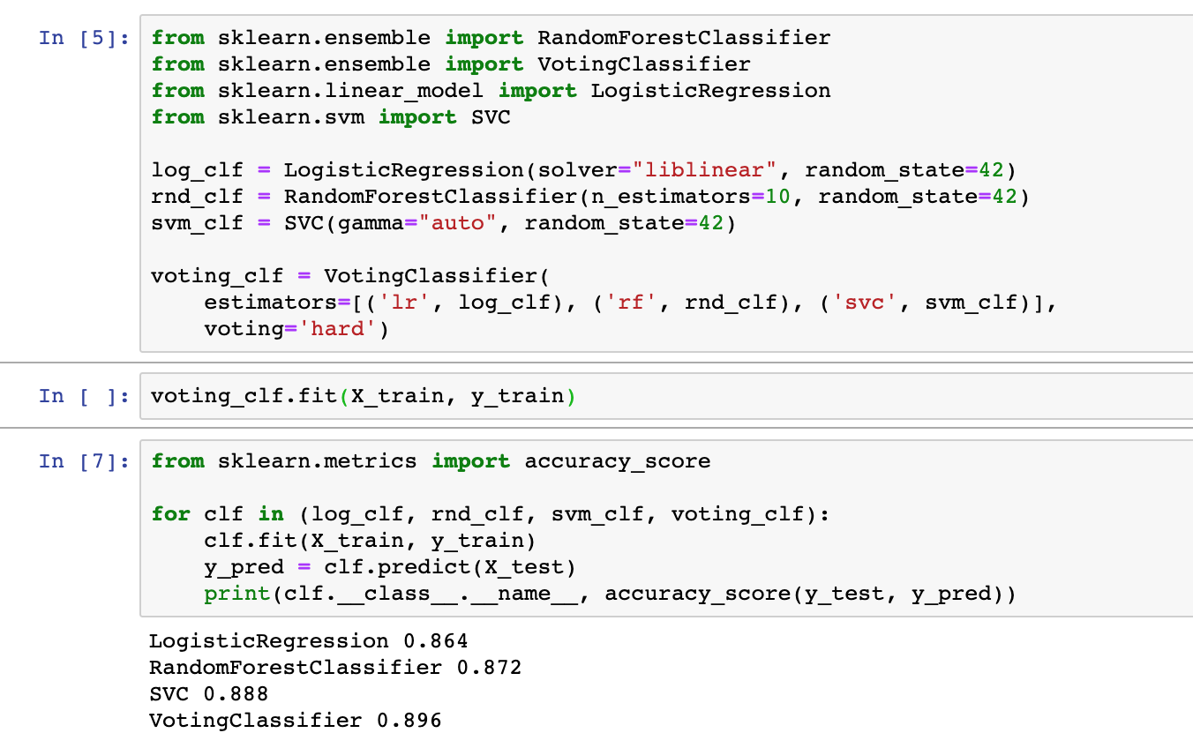
Hard voting
Source: Hands on Machine learning with scitkit-learn and tensorflow

Slide 7
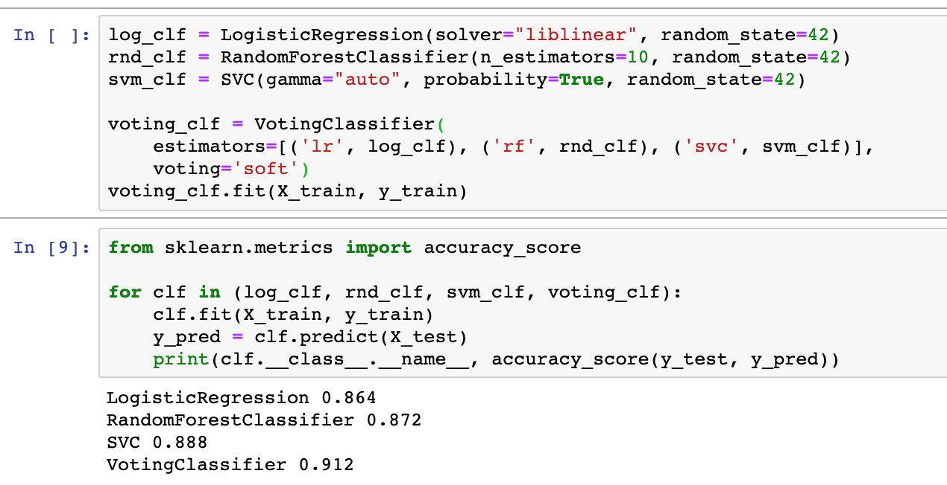
Soft voting
Source: Hands on Machine learning with scitkit-learn and tensorflow

Slide 8
Ensemble learning
There are two types of ensemble learning:
Bagging: train classifiers independently on random subsets of the training data
Boosting: Train classifiers sequentially, each time focusing on the training examples that the previous ones didn’t classify correctly
Bagging and boosting improve the model performance by addressing different issues
to understand their difference, we need to understand the decomposition of the generalization error
bias/Variance decomposition

Slide 9
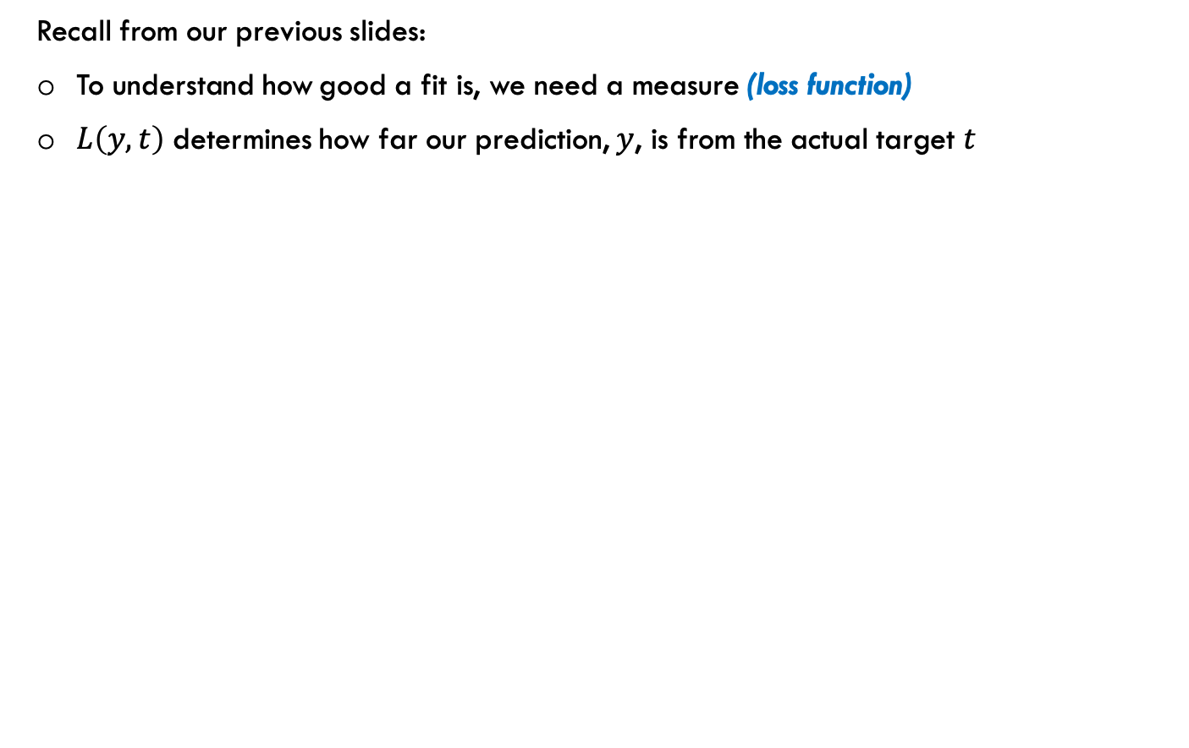
Loss Functions
Recall from our previous slides:
To understand how good a fit is, we need a measure (loss function)
$L\left(y,t\right)$ determines how far our prediction, $y$, is from the actual target $t$
Source: Slide credit: R grosse CSC411

Slide 10
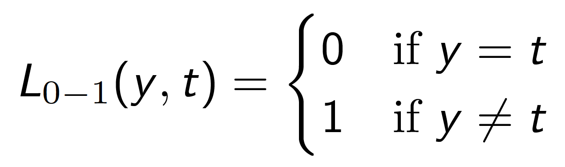
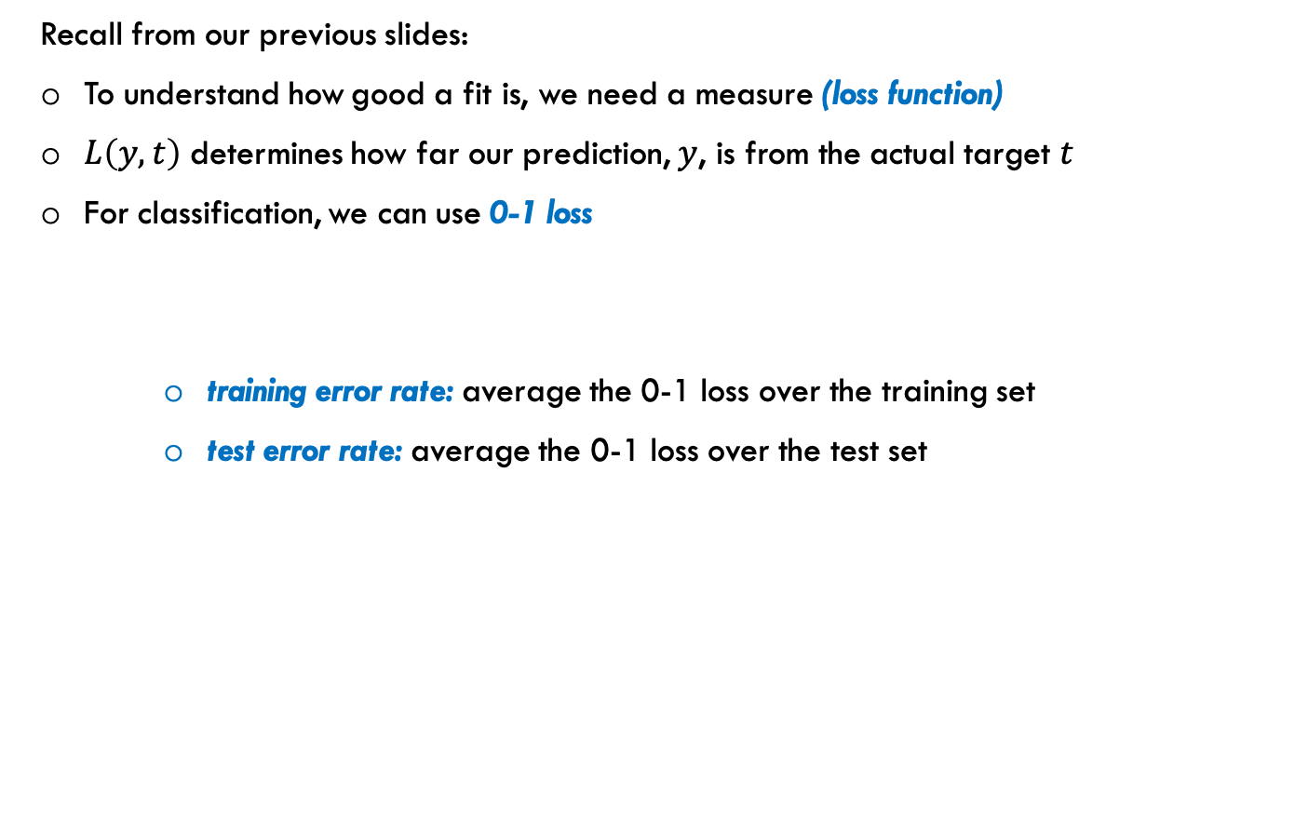
Loss Functions
Recall from our previous slides:
To understand how good a fit is, we need a measure (loss function)
$L\left(y,t\right)$ determines how far our prediction, $y$, is from the actual target $t$
For classification, we can use 0-1 loss
training error rate: average the 0-1 loss over the training set
test error rate: average the 0-1 loss over the test set
Source: Slide credit: R grosse CSC411

Slide 11
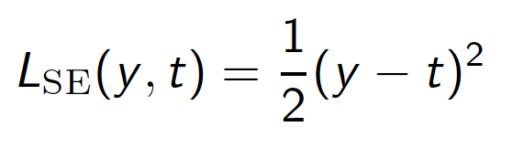
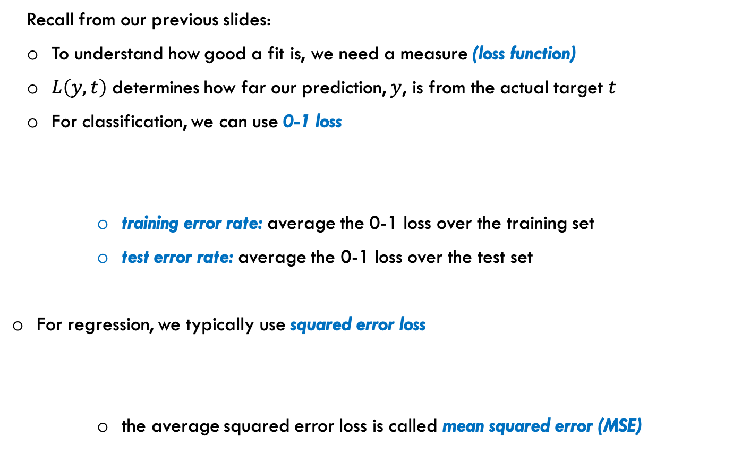
Loss Functions
Recall from our previous slides:
To understand how good a fit is, we need a measure (loss function)
$L\left(y,t\right)$ determines how far our prediction, $y$, is from the actual target $t$
For classification, we can use 0-1 loss
training error rate: average the 0-1 loss over the training set
test error rate: average the 0-1 loss over the test set
For regression, we typically use squared error loss
the average squared error loss is called mean squared error (MSE)
Source: Slide credit: R grosse CSC411

Slide 12
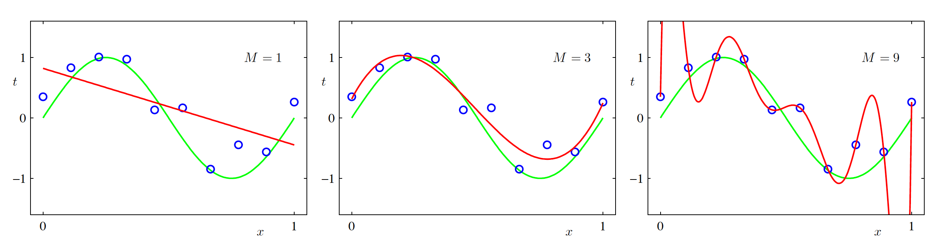
Generalization
The goal of machine learning is:
build a mathematical model on a set of data
that performs well on unseen examples
Generalization error: error on unseen examples
The entire goal of learning is minimizing the generalization error
How do we make sure the model generalizes to data it hasn't seen before?
Source: Slide credit: R grosse CSC411

Slide 13
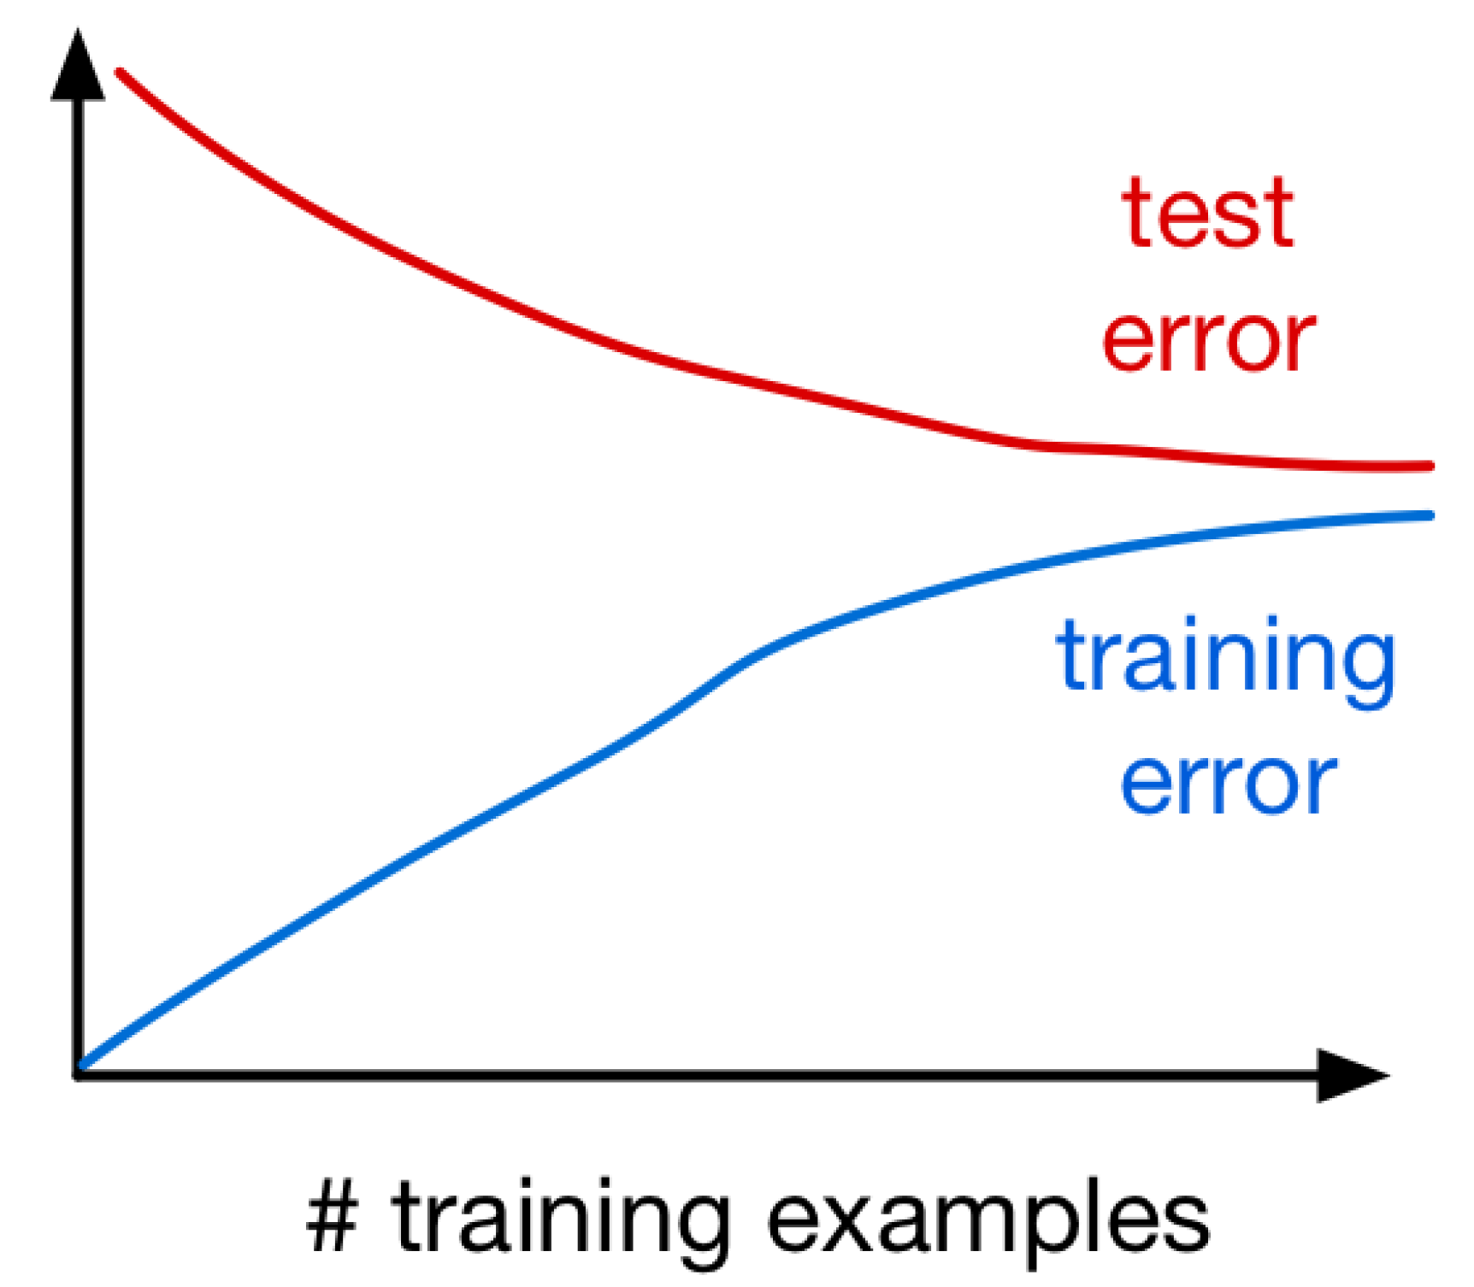
Generalization
The more training examples we have, the closer the train and test errors will be from each other

Slide 14
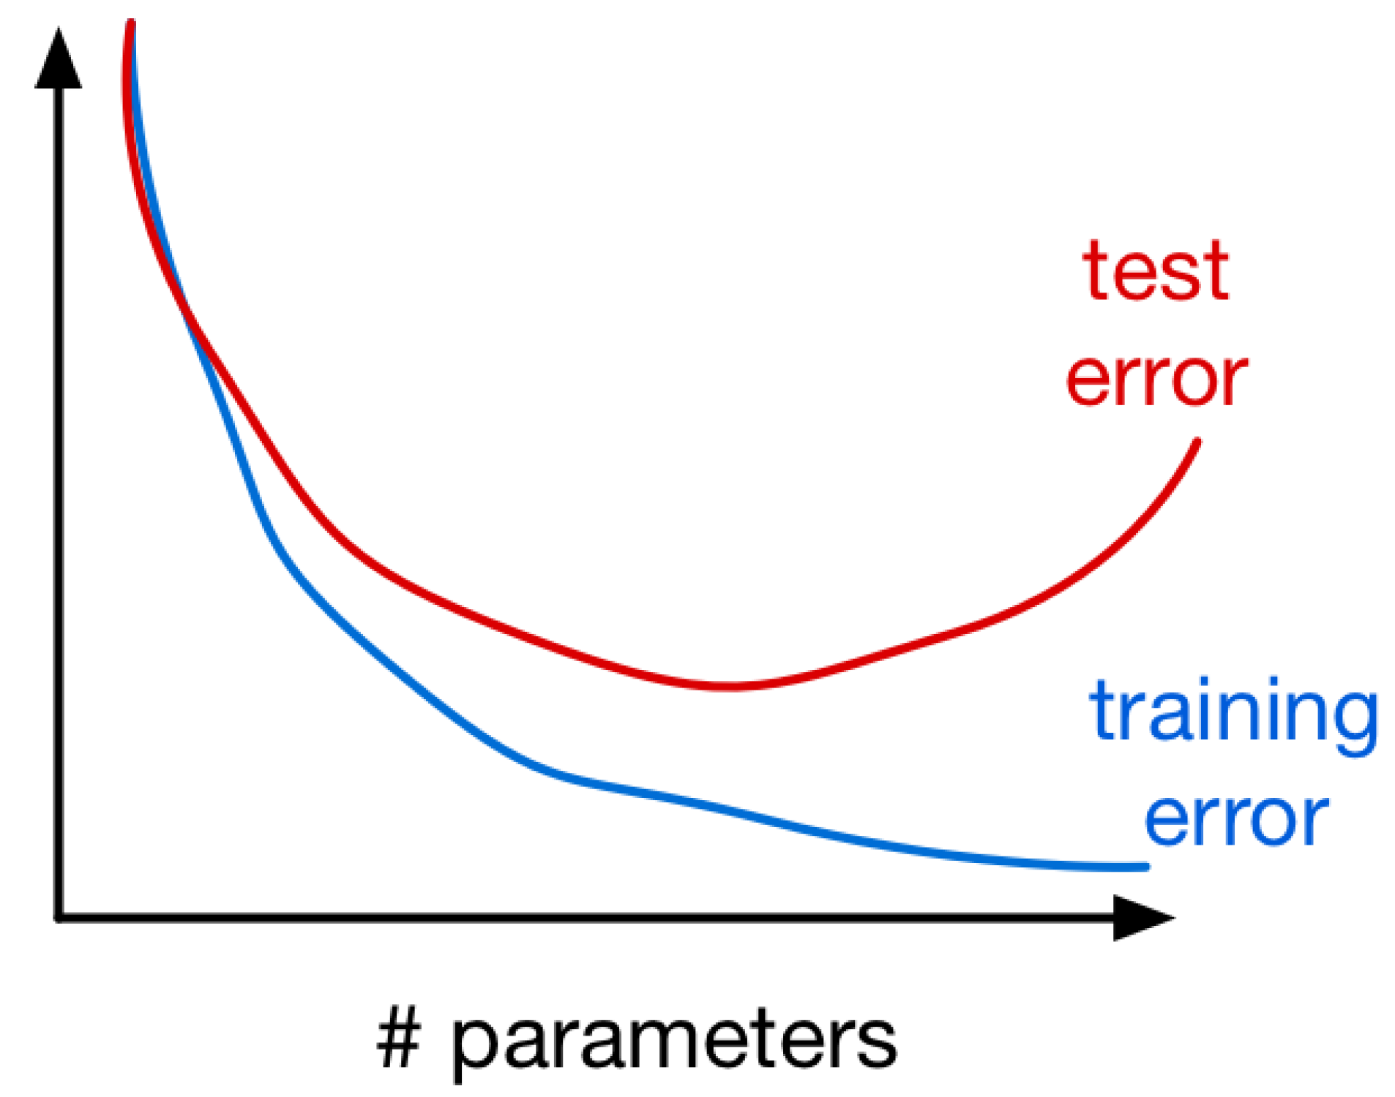
Generalization
The more training examples we have, the closer the train and test errors will be from each other
The more parameters we have, the further the train and test errors will be from each other

Slide 15
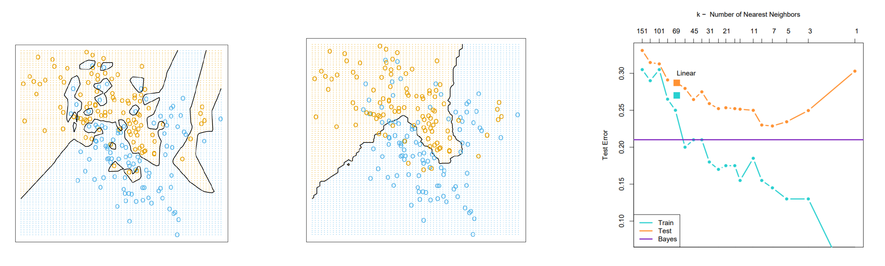
Bias/Variance decomposition
Recall from the first lecture:
extremely simple models underfit the data (k-NN with extremely large k)
extremely complex models overfit the data (k-NN with extremely small k)
Source: Slide credit: R grosse CSC411

Slide 16
Bias/Variance decomposition
Recall from the first lecture:
extremely simple models underfit the data (k-NN with extremely large k)
extremely complex models overfit the data (k-NN with extremely small k)
The underfit and overfit phenomenon can be quantified in terms of bias/variance
But, we have a training data, and typically the built model is deterministic
So, when we say bias and variance, what we are referring to?
Source: Slide credit: R grosse CSC411

Slide 17
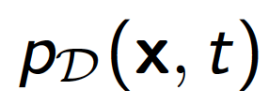
Bias/Variance decomposition
For squared error loss, the generalization error has an interesting decomposition
Suppose the training data D consists of i.i.d data points that are sampled from a data generating distribution
Pick an out of sample x, for which we would like to minimize the expected loss
Source: Slide credit: R grosse CSC411

Slide 18
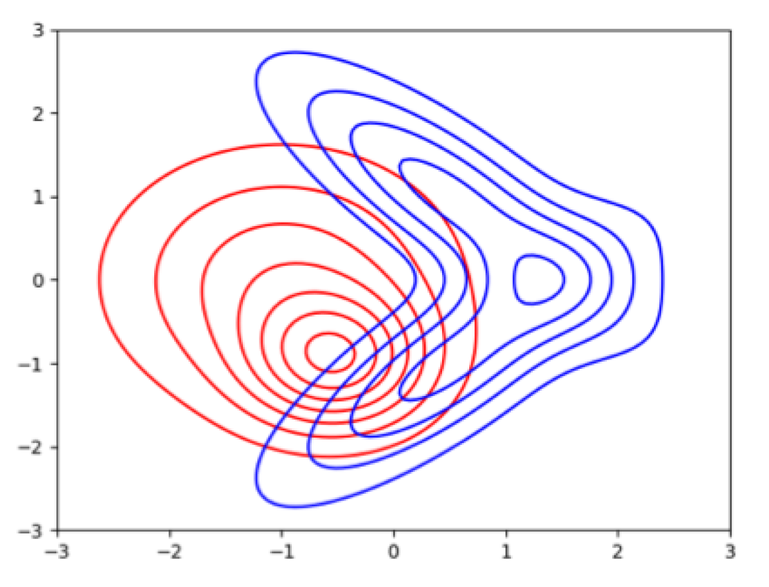
Bias/Variance decomposition
For squared error loss, the generalization error has an interesting decomposition
Suppose the training data D consists of i.i.d data points that are sampled from a data generating distribution
Pick an out of sample x, for which we would like to minimize the expected loss
Consider an experiment where we sample lots of training data independently from
Source: Slide credit: R grosse CSC411

Slide 19
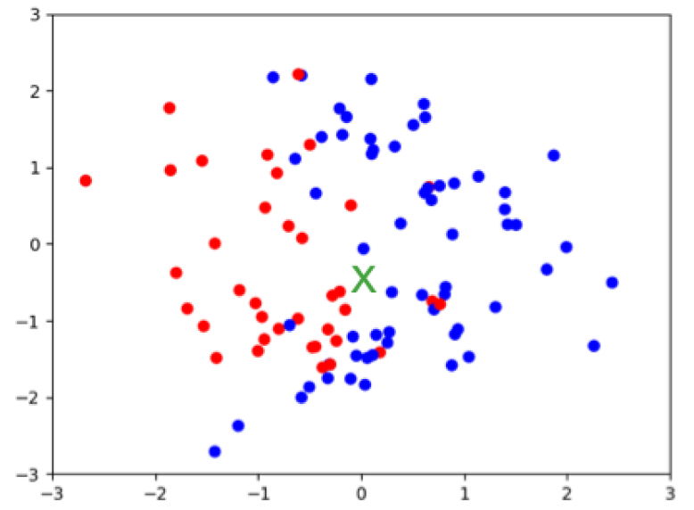
Bias/Variance decomposition
For squared error loss, the generalization error has an interesting decomposition
Suppose the training data D consists of i.i.d data points that are sampled from a data generating distribution
Pick an out of sample x, for which we would like to minimize the expected loss
Consider an experiment where we sample lots of training data independently from
Source: Slide credit: R grosse CSC411

Slide 20
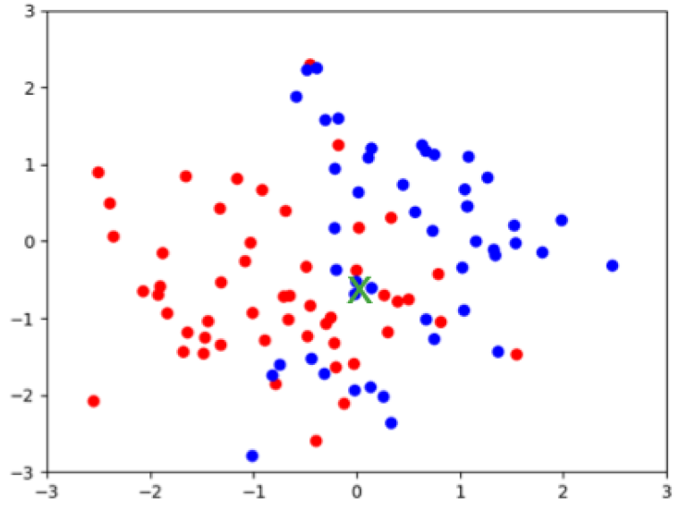
Bias/Variance decomposition
For squared error loss, the generalization error has an interesting decomposition
Suppose the training data D consists of i.i.d data points that are sampled from a data generating distribution
Pick an out of sample x, for which we would like to minimize the expected loss
Consider an experiment where we sample lots of training data independently from
Source: Slide credit: R grosse CSC411

Slide 21
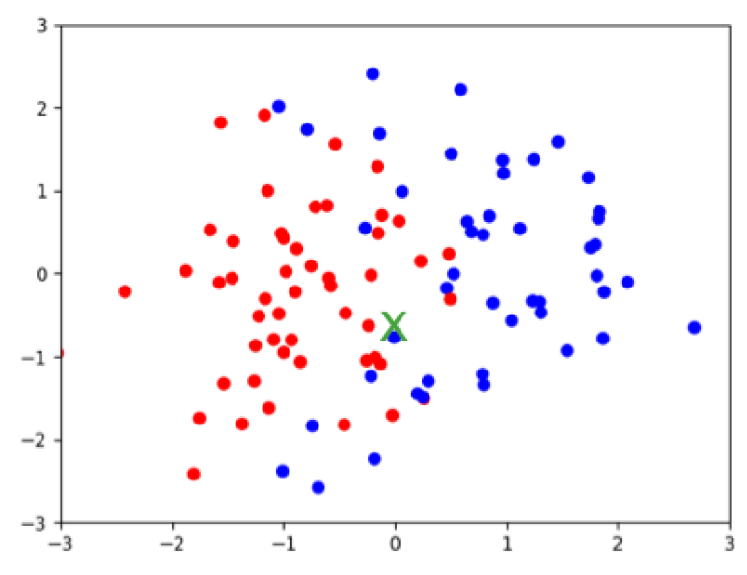
Bias/Variance decomposition
For squared error loss, the generalization error has an interesting decomposition
Suppose the training data D consists of i.i.d data points that are sampled from a data generating distribution
Pick an out of sample x, for which we would like to minimize the expected loss
Consider an experiment where we sample lots of training data independently from
Source: Slide credit: R grosse CSC411

Slide 22
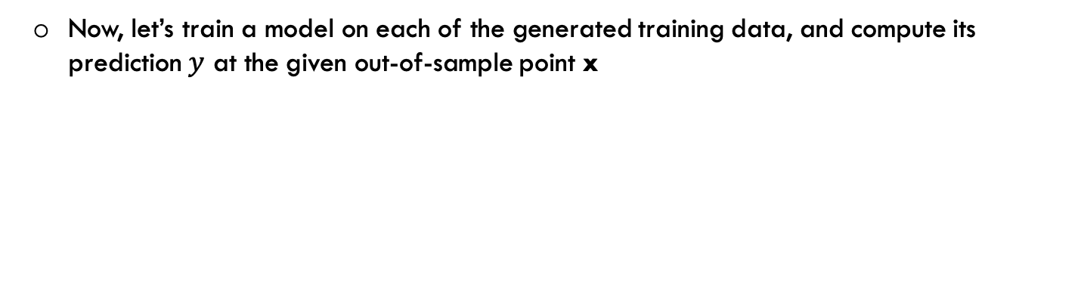
Bias/Variance decomposition
Now, let’s train a model on each of the generated training data, and compute its prediction $y$ at the given out-of-sample point x
Source: Slide credit: R grosse CSC411

Slide 23
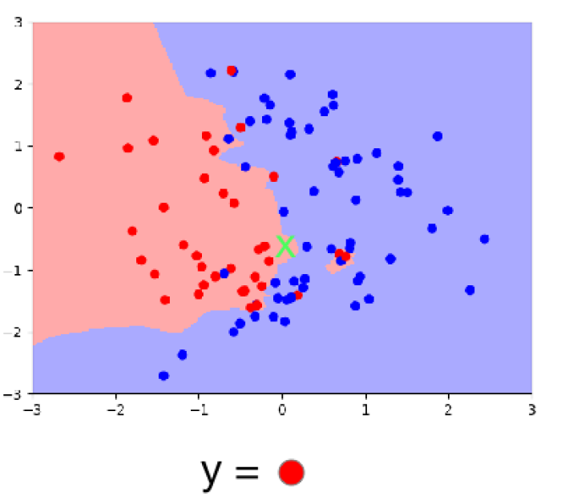
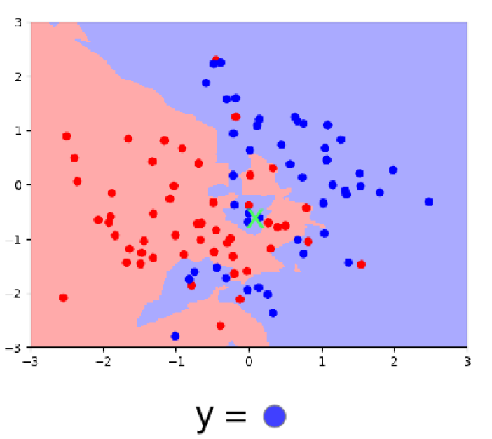
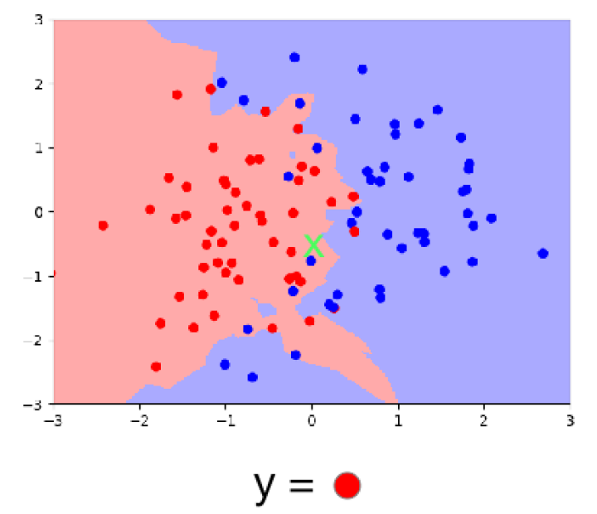
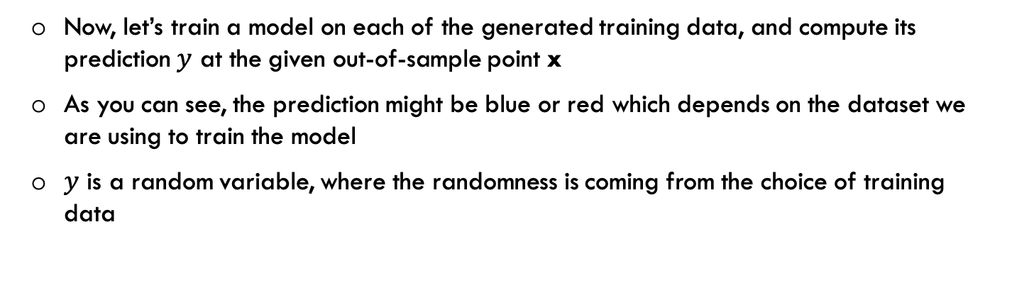
Bias/Variance decomposition
Now, let’s train a model on each of the generated training data, and compute its prediction $y$ at the given out-of-sample point x
As you can see, the prediction might be blue or red which depends on the dataset we are using to train the model
$y$ is a random variable, where the randomness is coming from the choice of training data
Source: Slide credit: R grosse CSC411

Slide 24
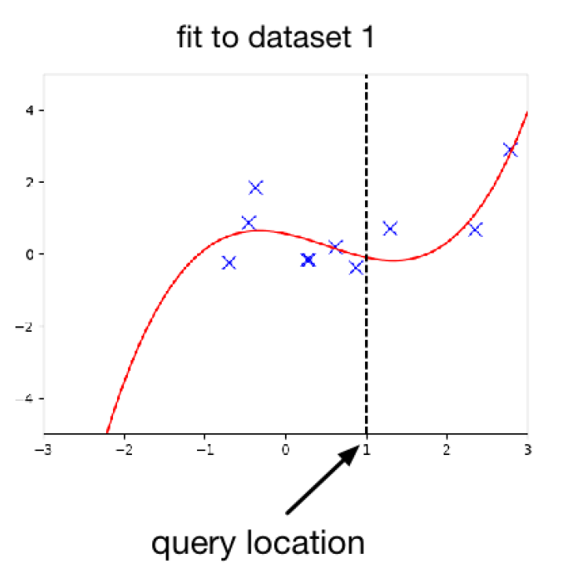
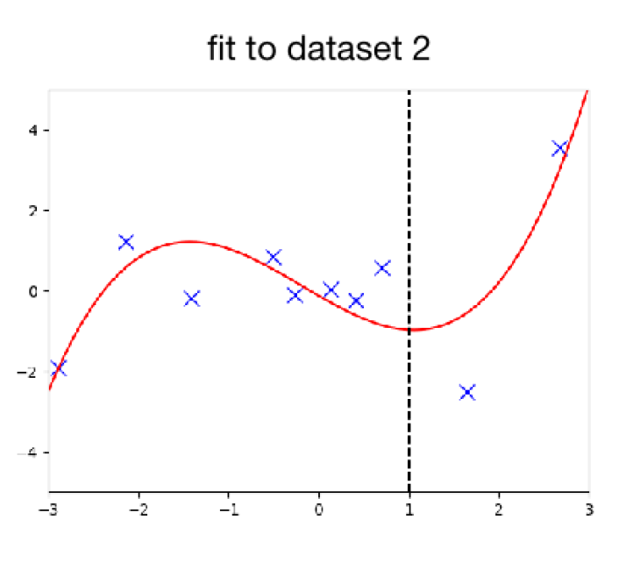
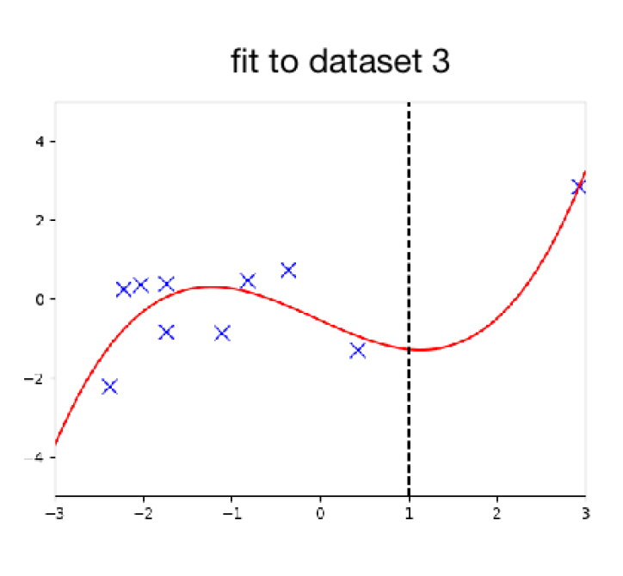
Bias/Variance decomposition
A similar set up for regression
Source: Slide credit: R grosse CSC411

Slide 25
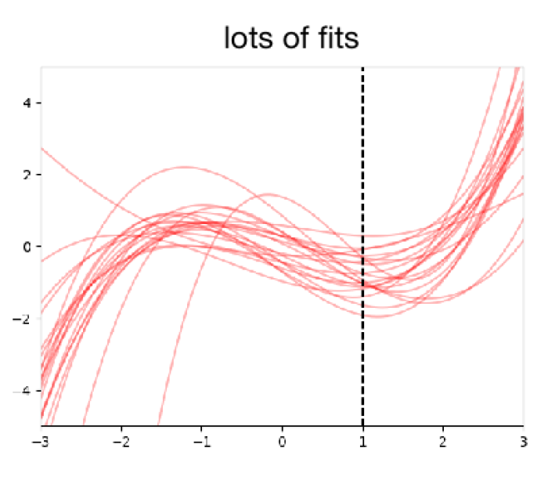
Bias/Variance decomposition
A similar set up for regression
Source: Slide credit: R grosse CSC411

Slide 26
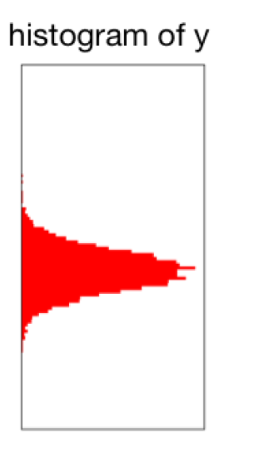
Bias/Variance decomposition
A similar set up for regression
Source: Slide credit: R grosse CSC411

Slide 27
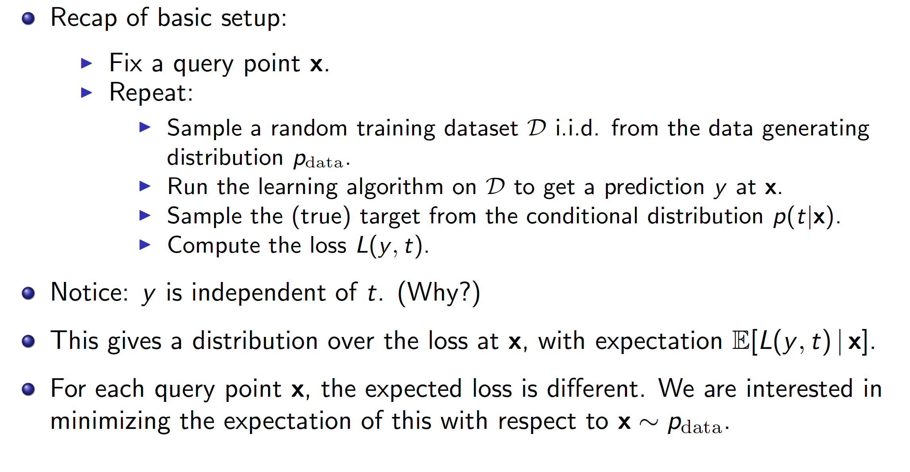
Bias/Variance decomposition
Source: Slide credit: R grosse CSC411

Slide 28
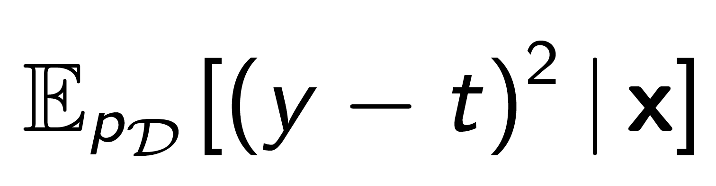
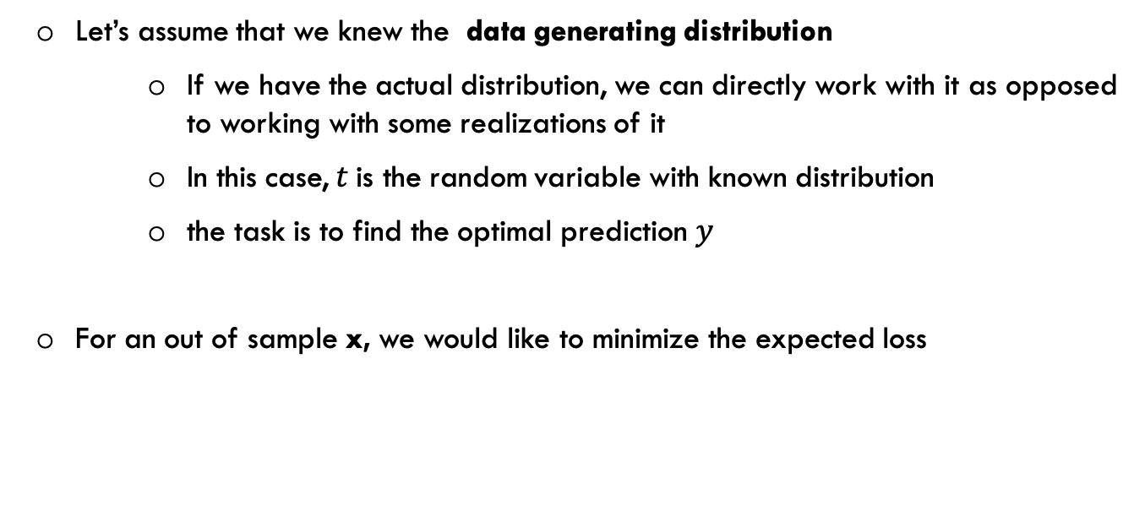
Bias/Variance decomposition
Let’s assume that we knew the data generating distribution
If we have the actual distribution, we can directly work with it as opposed to working with some realizations of it
In this case, $t$is the random variable with known distribution
the task is to find the optimal prediction $y$
For an out of sample x, we would like to minimize the expected loss

Slide 29
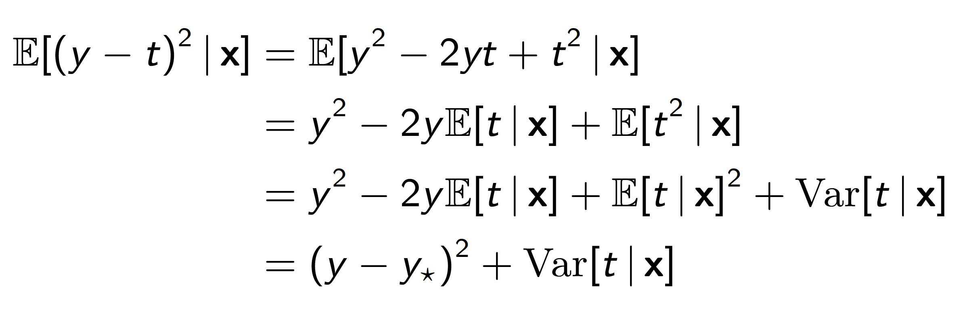
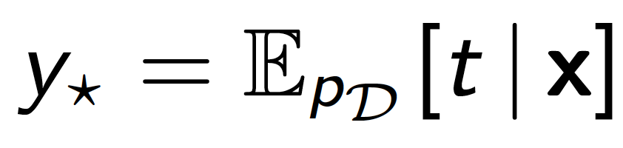
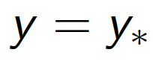
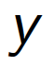
Bias/Variance decomposition
where
The first term is non-negative and can be made zero by picking
We don’t have any control on the second term since it doesn’t depend on
It comes from the noise of the target, and called Bayes error
This is the best we can ever hope to do with any learning algorithm
An algorithm that achieves this is called Bayes optimal
Therefore, is the best possible predictor
Source: Slide credit: R grosse CSC411

Slide 30
Bias/Variance decomposition
Suppose we sample a training set from data generating process, train a model on it, and use the model to make prediction y on test sample x
Here, y is a random variable, since it depends on random training set
The goal is to minimize the expected loss (expected test squared error)

Slide 31
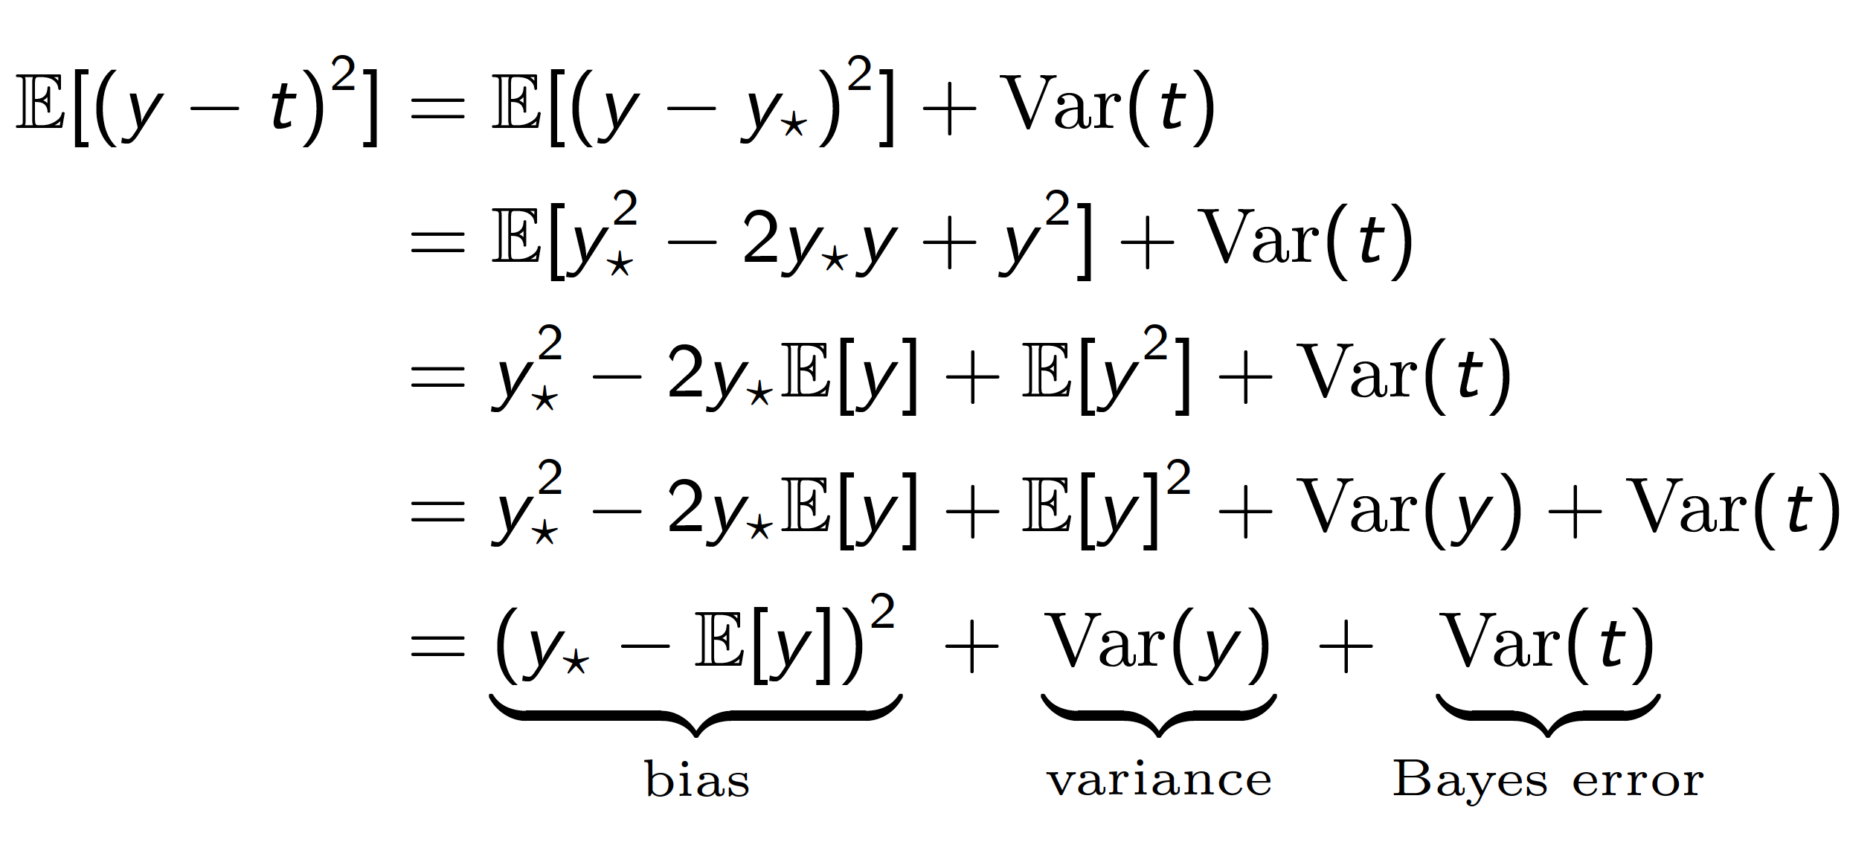
Bias/Variance decomposition
Suppose we sample a training set from data generating process, train a model on it, and use the model to make prediction y on test sample x
Here, y is a random variable, since it depends on random training set
The goal is to minimize the expected loss (Generalization error)
Source: Slide credit: R grosse CSC411

Slide 32
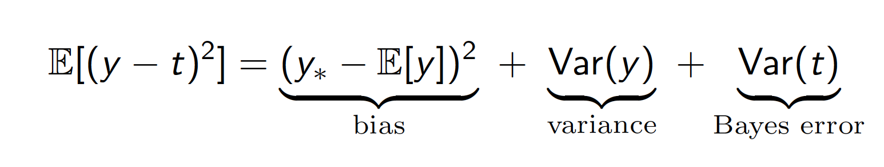
Bias/Variance decomposition
The expected error loss can be decomposed to three terms:
Bias: measures how wrong the expected prediction is
High bias is equivalent to underfit
Variance: measures the amount of variability in the prediction
High variance is equivalent to overfit
Bayes: the noise of the target
Even the best possible model cannot overcome this
Source: Slide credit: R grosse CSC411

Slide 33
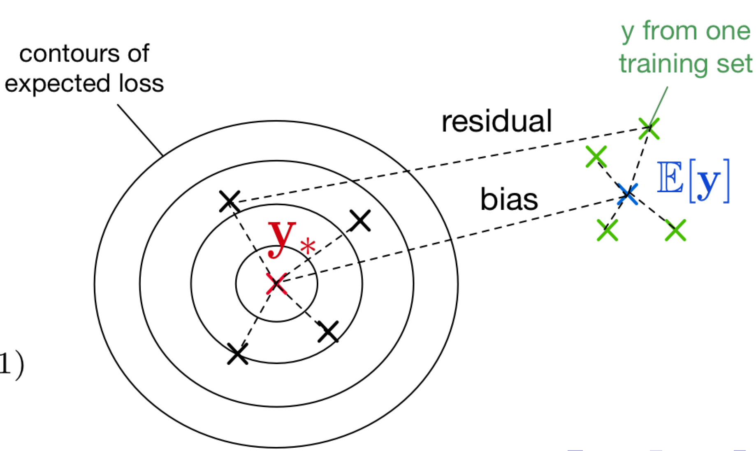

Bias/Variance Decomposition
If we have an overly simple model, it might have
high bias (because it's too simplistic to capture the structure in the data)
low variance (there's enough data to estimate the parameters)
Source: Slide credit: R grosse CSC411

Slide 34
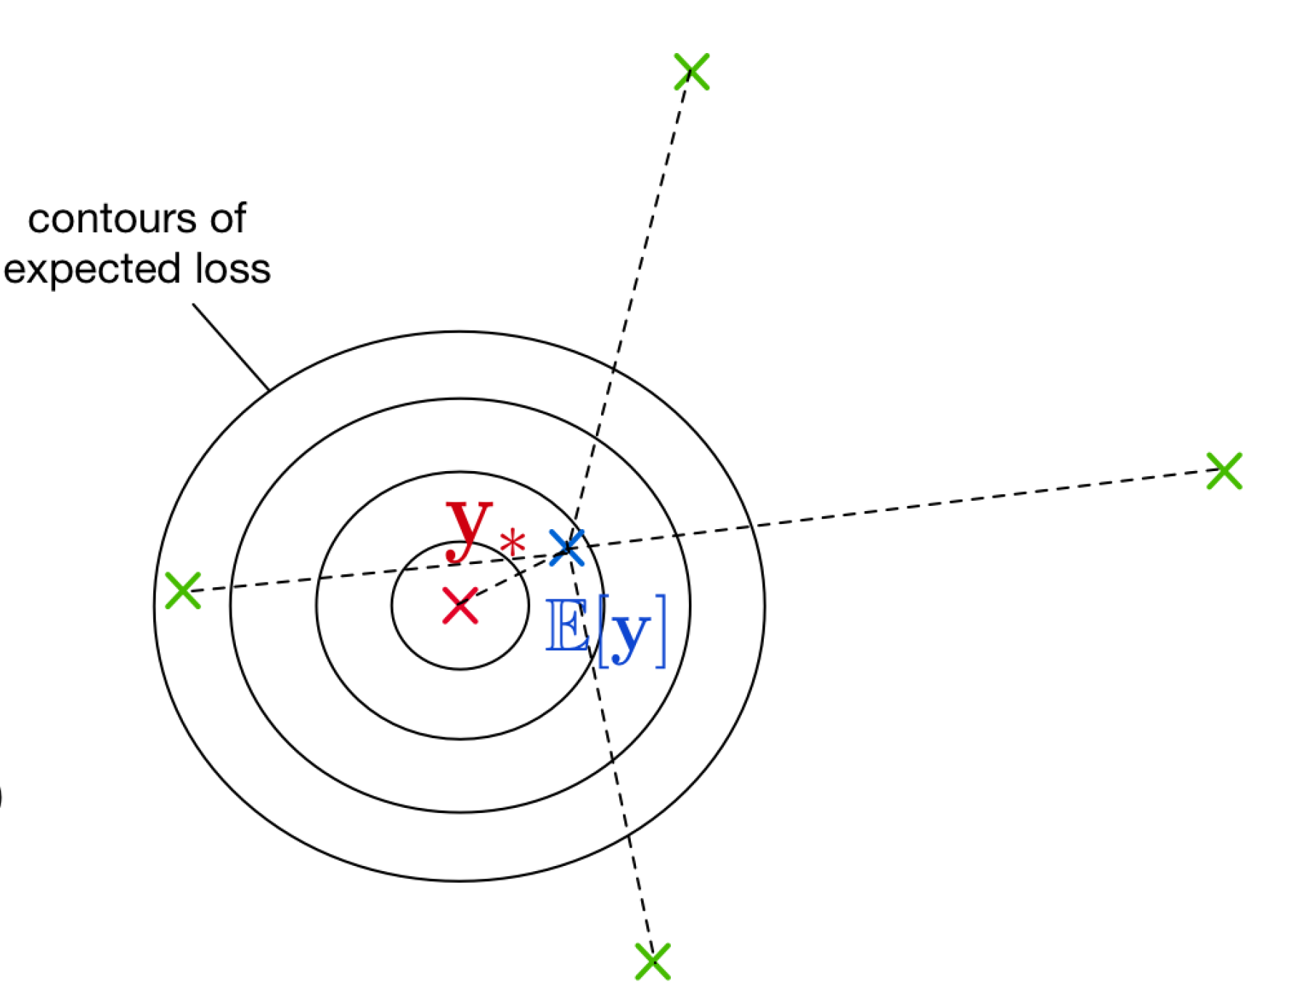

Bias/Variance Decomposition
If you have an overly complex model, it might have
low bias (since it learns all the relevant structure)
high variance (it fits the idiosyncrasies of the sampled data)
Source: Slide credit: R grosse CSC411

Slide 35
Polynomial fitting
Which one underfit, which one is overfit?
Source: Slide credit: R grosse CSC411

Slide 36
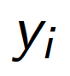
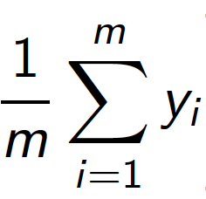
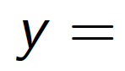
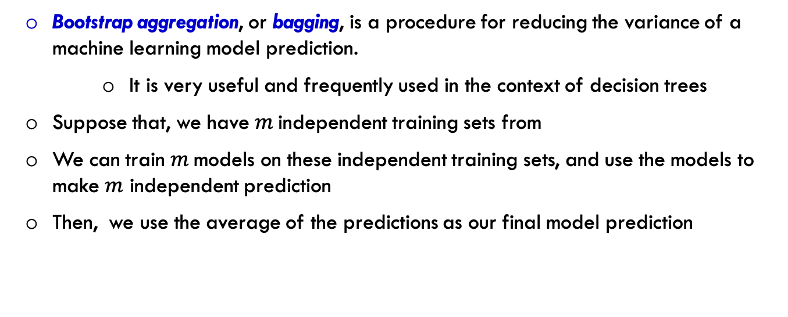
Bagging
Bootstrap aggregation, or bagging, is a procedure for reducing the variance of a machine learning model prediction.
It is very useful and frequently used in the context of decision trees
Suppose that, we have $m$independent training sets from
We can train $m$models on these independent training sets, and use the models to make $m$ independent prediction
Then, we use the average of the predictions as our final model prediction

Slide 37
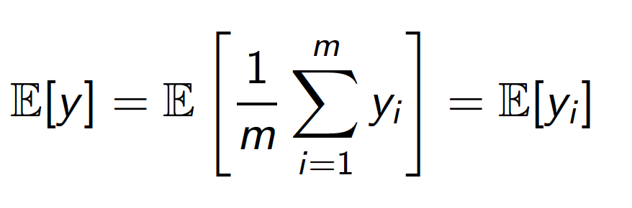
Bagging
Bias: unchanged

Slide 38
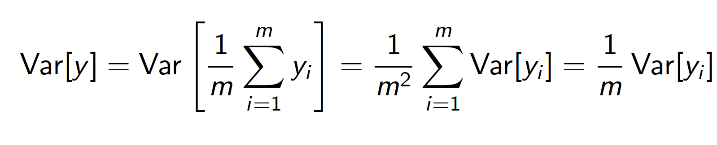
Bagging
Bias: unchanged
Variance: reduced. averaging set of independent observations

Slide 39
Bagging
Bias: unchanged
Variance: reduced. averaging set of independent observations
Bayes error: unchanged since we don’t have any control on it

Slide 40
Bagging
Therefore, to reduce variance, we need a set of nearly independent predictions
One way of doing that, is dividing our training sets to many subsets and then train model on each of them individually and then combine their predictions

Slide 41
Bagging
Therefore, to reduce variance, we need a set of nearly independent predictions
One way of doing that, is dividing our training sets to many subsets and then train model on each of them individually and then combine their predictions
But, the accuracy of each of the prediction get worse since we have less samples to train each of them

Slide 42
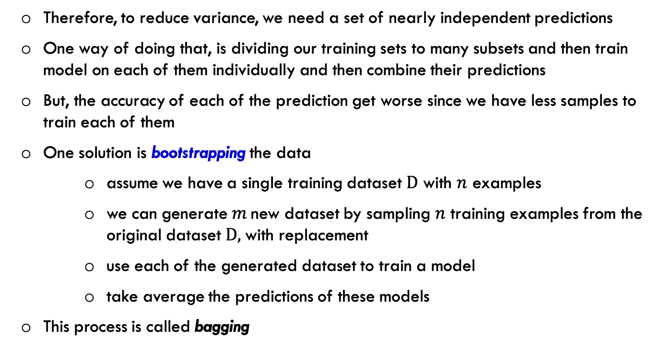
Bagging
Therefore, to reduce variance, we need a set of nearly independent predictions
One way of doing that, is dividing our training sets to many subsets and then train model on each of them individually and then combine their predictions
But, the accuracy of each of the prediction get worse since we have less samples to train each of them
One solution is bootstrapping the data
assume we have a single training dataset $D$ with $n$ examples
we can generate $m$new dataset by sampling $n$ training examples from the original dataset $D,$with replacement
use each of the generated dataset to train a model
take average the predictions of these models
This process is called bagging

Slide 43
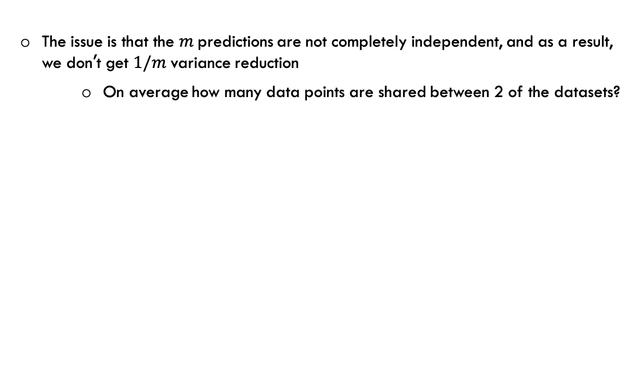
Bagging
The issue is that the $m$predictions are not completely independent, and as a result, we don’t get $1/m$ variance reduction
On average how many data points are shared between 2 of the datasets?

Slide 44
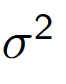
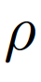
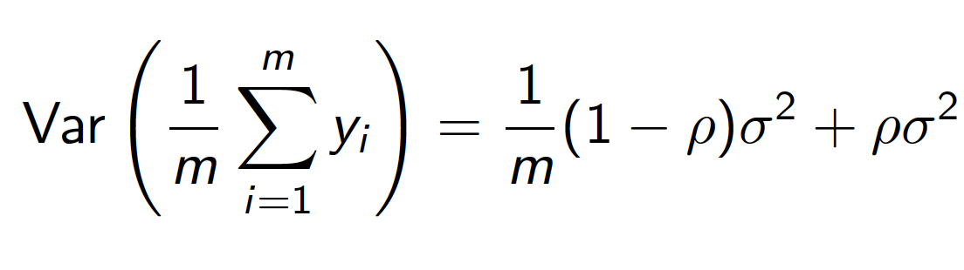

Bagging
The issue is that the $m$predictions are not completely independent, and as a result, we don’t get $1/m$ variance reduction
On average how many data points are shared between 2 of the datasets?
Prove that if the sampled predictions have variance and correlation , then

Slide 45

Bagging
The issue is that the $m$predictions are not completely independent, and as a result, we don’t get $1/m$ variance reduction
On average how many data points are shared between 2 of the datasets?
Prove that if the sampled predictions have variance and correlation , then
It can be advantageous to add some additional noise into the algorithm to reduce the correlation between the samples and make them more independent
We can use different training algorithms
We can use different hyper parameters
We can use a subset of features in each of the algorithm
All of these can help to reduce the samples correlation, and as a result reduce the variance

Slide 46

Random Forest
Random forest (RF) is a bagged ensemble of decision trees
It provides an improvement over bag trees decision trees by using a small trick that decorrelates the trees
Bagging part: build a number of decision trees on bootstrapped training samples
Trick: when building these decision trees, at each split node, only a random subset of features are chosen as split candidates, and a split is allowed to use only one feature out of this subset
A fresh random subset of predictors is taken at each split
In practice, we usually pick
the number of predictors considered at each split
total number of features
Source: A Introduction to Statistical Learning with Application in R, Trever Hastie and Rob Tibshirani

Slide 47

Summary of Bagging
Bagging reduces the generalization error by reducing variance
It is used in almost any state of art winning algorithm in the world
It has some limitations
The generated samples are not completely independent, and as a result we don’t get the $\frac{1}{m}$ variance reduction factor
Bagging doesn’t reduce bias.
In the next couple of slides, we will discuss about boosting which reduce bias
Random forests is a bagging technique with extra randomization
The randomization makes the generated predictions more independent

Slide 48
Boosting
Boosting is another ensemble method that can be applied to many machine learning methods for regression and classification
we mostly concentrate on classification
boosting is an ensemble method that can combine several weak learner into a strong learner
a weak learner is a learning algorithm that outputs a classifier that performs slightly better than chance (it predicts the correct label with probability 51% or so)
a desirable property of a weak learner is that it is computationally efficient
decision trees
decision stump: a decision tree with only a single split

Slide 49

Boosting
Boosting is another ensemble method that can be applied to many machine learning methods for regression and classification
we mostly concentrate on classification
boosting is an ensemble method that can combine several weak learner into a strong learner
a weak learner is a learning algorithm that outputs a classifier that performs slightly better than chance (it predicts the correct label with probability 51% or so)
a desirable property of a weak learner is that it is computationally efficient
decision trees
decision stump: a decision tree with only a single split
a decision stump partitions the input space to two half spaces

Slide 50

Boosting
Boosting is another ensemble method that can be applied to many machine learning methods for regression and classification
we mostly concentrate on classification
boosting is an ensemble method that can combine several weak learner into a strong learner
a weak learner is a learning algorithm that outputs a classifier that performs slightly better than chance (it predicts the correct label with probability 51% or so)
a desirable property of a weak learner is that it is computationally efficient
decision trees
decision stump: a decision tree with only a single split
a decision stump partitions the input space to two half spaces
vertical half-space

Slide 51

Boosting
Boosting is another ensemble method that can be applied to many machine learning methods for regression and classification
we mostly concentrate on classification
boosting is an ensemble method that can combine several weak learner into a strong learner
a weak learner is a learning algorithm that outputs a classifier that performs slightly better than chance (it predicts the correct label with probability 51% or so)
a desirable property of a weak learner is that it is computationally efficient
decision trees
decision stump: a decision tree with only a single split
a decision stump partitions the input space to two half spaces
horizontal half-space
Source: Slide credit: R grosse CSC411

Slide 52




Weak Classifiers and boosting
a decision stump is a weak classifier
It is very simple (horizontal/vertical half-space)
It performs slightly better than chance (50%+)
weighted classification error for a stump is
the idea of boosting is to combine many of these weak classifiers (stump) to make a better classifier
In that sense, boosting is very similar to bagging, except that the weak classifiers are trained sequentially.
Each tree is grown using information from previous trees
Focus more on the training samples that were misclassified in previous steps
It puts larger weights to the points that were misclassified previously
Source: Slide credit: R grosse CSC411

Slide 53
AdaBoost (Adaptive Boosting)
Repeat the following steps many times
At each iteration, we reweight the training samples by assigning larger weights to training samples that previously were misclassified
The error (loss function) is defined based on the new weights
Using weighted error, we train a new weak classifier (i.e. stump)
this weak learner minimizes the weighted error
We add the new classifier to the ensemble.
Source: Slide credit: R grosse CSC411

Slide 54


AdaBoost (Adaptive Boosting)
Let’s look at an example: first step
Source: Slide credit: R grosse CSC411

Slide 55


AdaBoost (Adaptive Boosting)
Let’s look at an example: first step
Source: Slide credit: R grosse CSC411

Slide 56
AdaBoost (Adaptive Boosting)
Let’s look at an example: first step
Source: Slide credit: R grosse CSC411

Slide 57

AdaBoost (Adaptive Boosting)
Let’s look at an example: first step
Source: Slide credit: R grosse CSC411

Slide 58
AdaBoost (Adaptive Boosting)
Let’s look at an example: second step
Source: Slide credit: R grosse CSC411

Slide 59


AdaBoost (Adaptive Boosting)
Let’s look at an example: second step
Source: Slide credit: R grosse CSC411

Slide 60
AdaBoost (Adaptive Boosting)
Let’s look at an example: second step
Source: Slide credit: R grosse CSC411

Slide 61

AdaBoost (Adaptive Boosting)
Let’s look at an example: second step
Source: Slide credit: R grosse CSC411

Slide 62


AdaBoost (Adaptive Boosting)
Let’s look at an example: second step
Source: Slide credit: R grosse CSC411

Slide 63

AdaBoost (Adaptive Boosting)
Final classifier
Source: Slide credit: R grosse CSC411

Slide 64

AdaBoost (Adaptive Boosting)
Final classifier
Source: Slide credit: R grosse CSC411

Slide 65

AdaBoost Algorithm
Source: Slide credit: R grosse CSC411

Slide 66

AdaBoost Algorithm
Source: Slide credit: R grosse CSC411

Slide 67


Adaboost – weak learners final weights
Source: Slide credit: R grosse CSC411

Slide 68




AdaBoost Algorithm intuition
small error rate (0%): then $α_{t}$ will be very large positive number
In final prediction, this classifier has a large weight
we change the next step’s weights in a very extreme way, the correct classified samples weights become much smaller, and the incorrect classified samples weight become much larger
Source: Slide credit: R grosse CSC411

Slide 69

AdaBoost Algorithm intuition
small error rate (0%): then $α_{t}$ will be very large positive number
In final prediction, this classifier has a large weight
we change the next step’s weights in a very extreme way, the correct classified samples weights become much smaller, and the incorrect classified samples weight become much larger
error rate around 50%: in this case $α_{t}$ will be close to zero
In final prediction, this classifier has a very small weight
The weights of the next step will have a very small change
Source: Slide credit: R grosse CSC411

Slide 70

AdaBoost Algorithm intuition
small error rate (0%): then $α_{t}$ will be very large positive number
In final prediction, this classifier has a large weight
we change the next step’s weights in a very extreme way, the correct classified samples weights become much smaller, and the incorrect classified samples weight become much larger
error rate around 50%: in this case $α_{t}$ will be close to zero
In final prediction, this classifier has a very small weight
The weights of the next step will have a very small change
error rate close to 100%: then $α_{t}$ will be very large negative number
In final prediction, this complement classifier has a large weight
we change the next step’s weights in a very extreme way, the correct classified samples weights become much larger, and the incorrect classified samples weight become much smaller
Source: Slide credit: R grosse CSC411

Slide 71
Gradient Boosting
Almost any other boosting algorithm is a special case of Gradient boosting
Gradient boosted trees, Adaboost, Binomial boosting
To understand Gradient boosting, we need to cover some mathematical background
Source: David Rosenberg, ML 101

Slide 72





Linear model with basis functions
Choose the basis functions on input space:
For polynomial regression, what are these basis functions?
Use the model as the linear combination of basis functions
As opposed to polynomial regression, we can actually learn these basis functions
Consider the base hypothesis space consisting of functions
for example, it can be the space of all possible decision stumps
An adaptive basis function expansion over is:
Source: David Rosenberg, ML 101

Slide 73




Adaptive Basis Models
Suppose we are given training data
Learning is choosing and to fit the training data
This can be done, by finding v’s and h’s that minimize the following objective function
How can we minimize J?
Source: David Rosenberg, ML 101

Slide 74


Adaptive Basis Models
Suppose we are given training data
Learning is choosing and to fit the training data
This can be done, by finding v’s and h’s that minimize the following objective function
How can we minimize J?
Suppose the base hypothesis space can be parameterized by
Can we differentiate J w.r.t $v_{m}$’s and $θ_{m}$’s? Optimize with SGD?
For some functions it is possible. Neural networks belong to this category
How about if the base functions are decision trees?
Can we parameterize decision trees with $θ?$
Even if we can, prediction would not change continuously w.r.t $θ$
Source: David Rosenberg, ML 101

Slide 75

Gradient Boosting
Using gradient boosting only makes sense when:
The loss function is differentiable w.r.t training predictions $f\left(x_{i}\right)$
We can do regression with the base hypothesis space
Something like decision tree
Source: David Rosenberg, ML 101

Slide 76





Forward Stage-wise Additive Modeling (FSAM)
It is an iterative optimization algorithm for fitting adaptive basis models
We start with $f_{0}=0$
After $m−1$ stage, we have
At $m^{′}th$iteration, we want to find
$h_{m}$ : step direction
$v_{m}$ : step size
Such that
improves objective function value by as much as possible
Source: David Rosenberg, ML 101

Slide 77



Forward Stage-wise Additive Modeling (FSAM)
It is an iterative optimization algorithm for fitting adaptive basis models
We start with $f_{0}(x)=0$
For $m=1 to M:$
Compute
Set
The final solution is $f_{M}$
Source: David Rosenberg, ML 101

Slide 78


$L^{2}$Boosting
The loss function is squared loss. Basically, at each step, we minimize
Source: David Rosenberg, ML 101

Slide 79


$L^{2}$Boosting
The loss function is squared loss. Basically, at each step, we minimize
If the hypothesis set is closed under rescaling we can drop $v$ from the equation
Take $v=1$ and minimize
Source: David Rosenberg, ML 101

Slide 80

$L^{2}$Boosting
The loss function is squared loss. Basically, at each step, we minimize
If the hypothesis set is closed under rescaling we can drop $v$ from the equation
Take $v=1$ and minimize
optimal choice at m$−1$
Source: David Rosenberg, ML 101

Slide 81

$L^{2}$Boosting
The loss function is squared loss. Basically, at each step, we minimize
If the hypothesis set is closed under rescaling we can drop $v$ from the equation
Take $v=1$ and minimize
optimal choice at m$−1$
residual at m$−1$
Source: David Rosenberg, ML 101

Slide 82

$L^{2}$Boosting
The loss function is squared loss. Basically, at each step, we minimize
If the hypothesis set is closed under rescaling we can drop $v$ from the equation
Take $v=1$ and minimize
This is basically fitting the residuals with least-squared regression
Therefore, if we can do regression with our hypothesis space, then we are set!
New decision tree, we use to fit the residuals
optimal choice at m$−1$
residual at m$−1$
Source: David Rosenberg, ML 101

Slide 83




$L^{2}$Boosting
Consider the hypothesis space of regression stumps
Consider FSAM with $L^{2}$loss
Let’s find the best adaptive basis model for the following 1-dimensional training data
Source: David Rosenberg, ML 101

Slide 84

$L^{2}$Boosting
Consider the hypothesis space of regression stumps
Consider FSAM with $L^{2}$loss
Let’s find the best adaptive basis model for the following 1-dimensional training data
Source: David Rosenberg, ML 101

Slide 85

$L^{2}$Boosting
Consider the hypothesis space of regression stumps
Consider FSAM with $L^{2}$loss
Let’s find the best adaptive basis model for the following 1-dimensional training data
Source: David Rosenberg, ML 101

Slide 86

$L^{2}$Boosting
Consider the hypothesis space of regression stumps
Consider FSAM with $L^{2}$loss
Let’s find the best adaptive basis model for the following 1-dimensional training data
Source: David Rosenberg, ML 101

Slide 87




AdaBoost: Special Gradient Boosting
Consider a classification setting where $y_{i}∈\left\{−1,+1\right\}$
Consider exponential loss function defined as
Let be a base hypothesis space of classifiers
Then, reduces to Adaboost
Try to prove it yourself
Source: David Rosenberg, ML 101

Slide 88
Gradient Descent: Iterative algorithm to minimize the cost function
Gradient Descent is a way to minimize the cost function
Gradient Descent is an iterative algorithm: We update the parameters repeatedly until some certain criteria is met
You start with some reasonable set of parameters
On each iteration, update the parameters in the direction of steepest descent (opposite direction of the gradient of the objective function)

Slide 89

Gradient Descent

Slide 90


Gradient Descent
Gradient:
In 1-dimention, the gradient is the derivative of the function
In multiple dimension, the gradient is the vector of partial derivatives along each dimension

Slide 91






Gradient Descent
Increasing Increases the loss function
Increasing Decreases the loss function
The following update decreases the loss function
is the learning rate.
The larger it is, the faster parameter changes

Slide 92

Gradient Boosting
Recall at each FSAM step, we want to solve the following optimization problem
One way to find the optimal $h$, is to use locally best step direction
Like gradient descent.
Source: David Rosenberg, ML 101

Slide 93


Gradient Boosting
Recall at each FSAM step, we want to solve the following optimization problem
One way to find the optimal $h$, is to use locally best step direction
Like gradient descent.
More generally, the goal is to find an optimal $f$ that minimizes
Let’s use gradient descent, but what does it mean to do gradient with respect to $f$
Source: David Rosenberg, ML 101

Slide 94

Gradient Boosting
Recall at each FSAM step, we want to solve the following optimization problem
One way to find the optimal $h$, is to use locally best step direction
Like gradient descent.
More generally, the goal is to find an optimal $f$ that minimizes
$J\left(f\right)$ only depends on $f$at the $n$ training points
Source: David Rosenberg, ML 101

Slide 95



Gradient Boosting
Recall at each FSAM step, we want to solve the following optimization problem
One way to find the optimal $h$, is to use locally best step direction
Like gradient descent.
More generally, the goal is to find an optimal $f$ that minimizes
$J\left(f\right)$ only depends on $f$at the $n$ training points
We can define , and rewrite J as:
Source: David Rosenberg, ML 101

Slide 96


Gradient Boosting
Consider gradient descent on:
Recall, to minimize J, it is optimal to move in negative gradient step direction:
is the direction we want to change each of our n predictions on training data
Source: David Rosenberg, ML 101

Slide 97




Gradient Boosting
Consider gradient descent on:
Recall, to minimize J, it is optimal to move in negative gradient step direction:
is the direction we want to change each of our n predictions on training data
So, for a moment, let’s forget that our next h is supposed to be selected from the hypothesis set. Lets not put any restriction on it. Then, the optimal path would be:
$$f_{0}$$
$$f_{1}$$
$$f_{M}$$
Source: David Rosenberg, ML 101

Slide 98
Gradient Boosting
The unconstrained optimal direction
is called pseudo residuals (remember for square loss, they were exactly the residuals)
In reality, we are restricted to select our next step update from a set of hypothesis, and we cannot select an unconstrained update direction
Source: David Rosenberg, ML 101

Slide 99



Gradient Boosting
The unconstrained optimal direction
is called pseudo residuals (remember for square loss, they were exactly the residuals)
In reality, we are restricted to select our next step update from a set of hypothesis, and we cannot select an unconstrained update direction
How about if we find the closest hypothesis to the optimal path
This is the least square regression problem over hypothesis space
Take the that best approximates as our next step
Source: David Rosenberg, ML 101

Slide 100

Gradient Boosting
Closest hypothesis to the optimal unconstrained path
Optimal unconstrained direction
Source: David Rosenberg, ML 101

Slide 101


Gradient Boosting- Step size
Finally, we need to choose step size
Option 1: solve the following optimization problem
Option 2: Treat it as Shrinkage parameter
This is more common
$v=1$is considered to be full gradient step
Choose some $v in [0,1].$Called shrinkage parameter
A value of $v=0.1$ is typical. But we can optimize it as a hyper parameter
Source: David Rosenberg, ML 101

Slide 102

Sinc Function: Toy example
Source: David Rosenberg, ML 101: From Natekin and Knoll’s "Gradient boosting machines, a tutorial"

Slide 103



Sinc Function: Training performance/Ensemble Size
Number of steps = 1
$$λ=1$$
Here, we changed the convention.
Instead of $ν,$ I am using $λ$
Source: David Rosenberg, ML 101: From Natekin and Knoll’s "Gradient boosting machines, a tutorial"

Slide 104
Sinc Function: Training performance/Ensemble Size
Number of steps = 1
Number of steps = 10
$$λ=1$$
Source: David Rosenberg, ML 101: From Natekin and Knoll’s "Gradient boosting machines, a tutorial"

Slide 105
Sinc Function: Training performance/Ensemble Size
Number of steps = 1
Number of steps = 10
$$λ=1$$
Number of steps = 50
Number of steps = 100
Source: David Rosenberg, ML 101: From Natekin and Knoll’s "Gradient boosting machines, a tutorial"

Slide 106

Sinc Function: Toy example
Source: David Rosenberg, ML 101: From Natekin and Knoll’s "Gradient boosting machines, a tutorial"

Slide 107
Sinc Function: Toy example
Source: David Rosenberg, ML 101: From Natekin and Knoll’s "Gradient boosting machines, a tutorial"

Slide 108

Gradient Boosting- Recap
Source: David Rosenberg, ML 101

